Slide 1
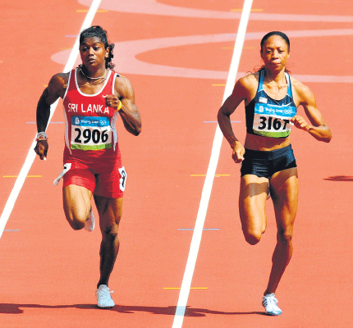
Glycolysis
P.M.T.B Wickramasinghe BSc PhD
Dept. of Biochemistry and Clinical Chemistry
03/01/2018
Notes:
What students know about glycolysis. Essential pathway in glucose metabolism. Takes place in the cytoplasm.

Slide 4
Objectives
At the end of this lecture student should be able to,
Define Glycolysis
Outline the sequence of reactions
Identify irreversible, key regulatory, energy consuming and generating steps
List sites of substrate level phosphorylation
Describe Allosteric and hormonal regulation of glycolysis

Slide 5
Objectives
At the end of this lecture student should be able to,
Understand the physiological basis for the different affinities for glucose in glucokinase and hexokinase
Describe the fate of glucose under anaerobic and aerobic conditions
Outline the fate of pyruvate and NADH produced
Explain the clinical consequences of inherited defects in glycolytic enzymes with special reference to mature red blood cells

Slide 6
Significance of glycolysis
Physiological importance
First step in utilization of glucose and other monosaccharides/major role in glucose homeostasis
Provides precursors for important biomolecules
ATP production under both aerobic and anaerobic respiration
Clinical relevance
Congenital defects in glycolytic enzymes
Clinical chemistry concerns
Detection (and possible treatment) of cancers
Notes:
Discussed unger

Slide 8
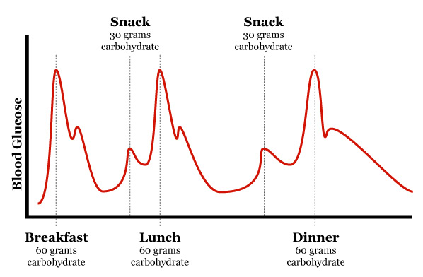
Glucose homeostasis
Blood glucose levels tightly regulated between 80-150 mg/dL in healthy people
Hormone mediated regulation of ;
Glucose uptake and trapping (High energy state)
Glucose production and release (Low energy state)

Slide 9
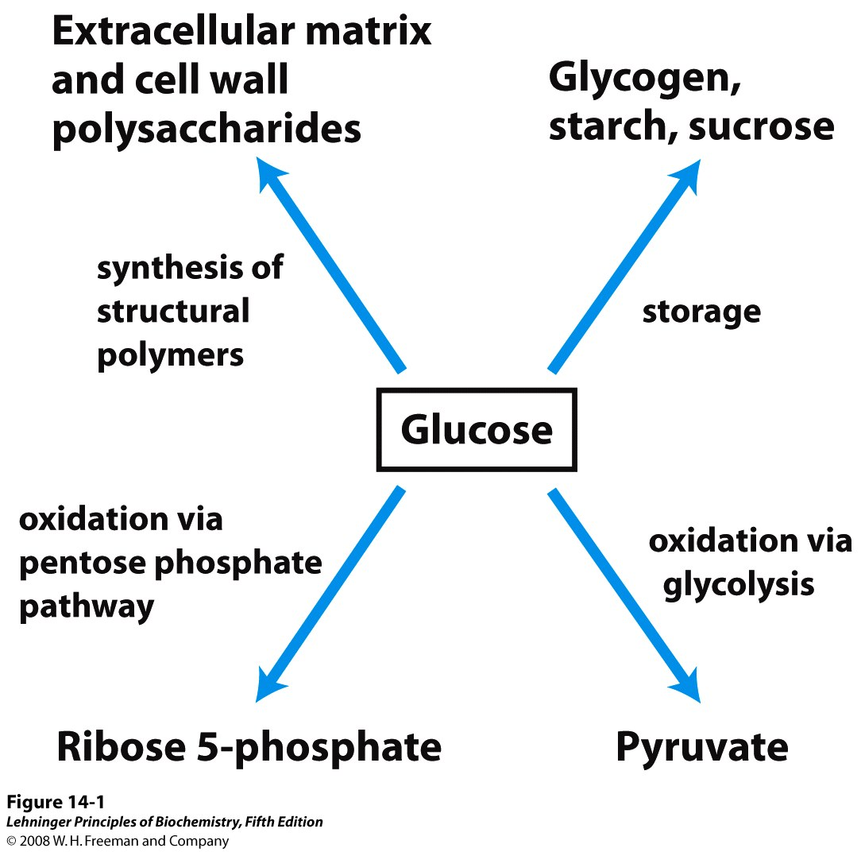
Major pathways of glucose utilization
RBCs
Brain cells
Muscles
Notes:
9

Slide 10
Glucose transporters
Glucose absorption from the lumen of intestine is primarily via Na-dependent glucose co-transporters
A family of facilitative glucose transporters transport glucose in and out of cells
GLUT-1 and 3 (low velocity, high affinity)
GLUT-2 (high velocity, low affinity)
GLUT-4 (insulin dependent, low velocity, high affinity)

Slide 11
Glucose uptake into the body
Postprandial glucose disposal
Two main modes.
-Insulin dependent
-Insulin independent
30 % is taken up by liver in the first pass
The rest of the glucose is taken up by other tissues/organs

Slide 13
Glycolysis overview
10 reactions occurring in the cytosol
2 Phases :
1. Preparatory Phase :
reactions 1-5, uses 2 ATPs
2. Payoff Phase : reactions 6-10, generate 4 ATPs by substrate level phosphorylation and 2 NADH
Glucose +2NAD⁺
+2ADP +2 Pi
2 pyruvate +2NADH
+2ATP +2 H₂O + 2H⁺

Slide 15
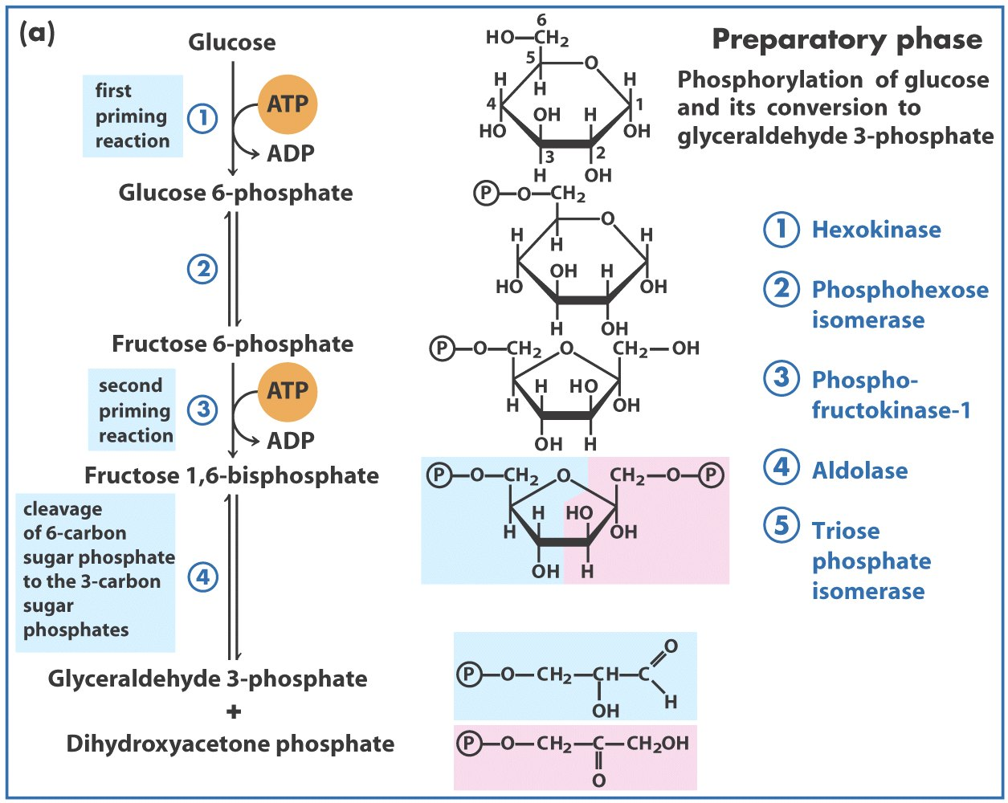
Preparatory Phase

Slide 16
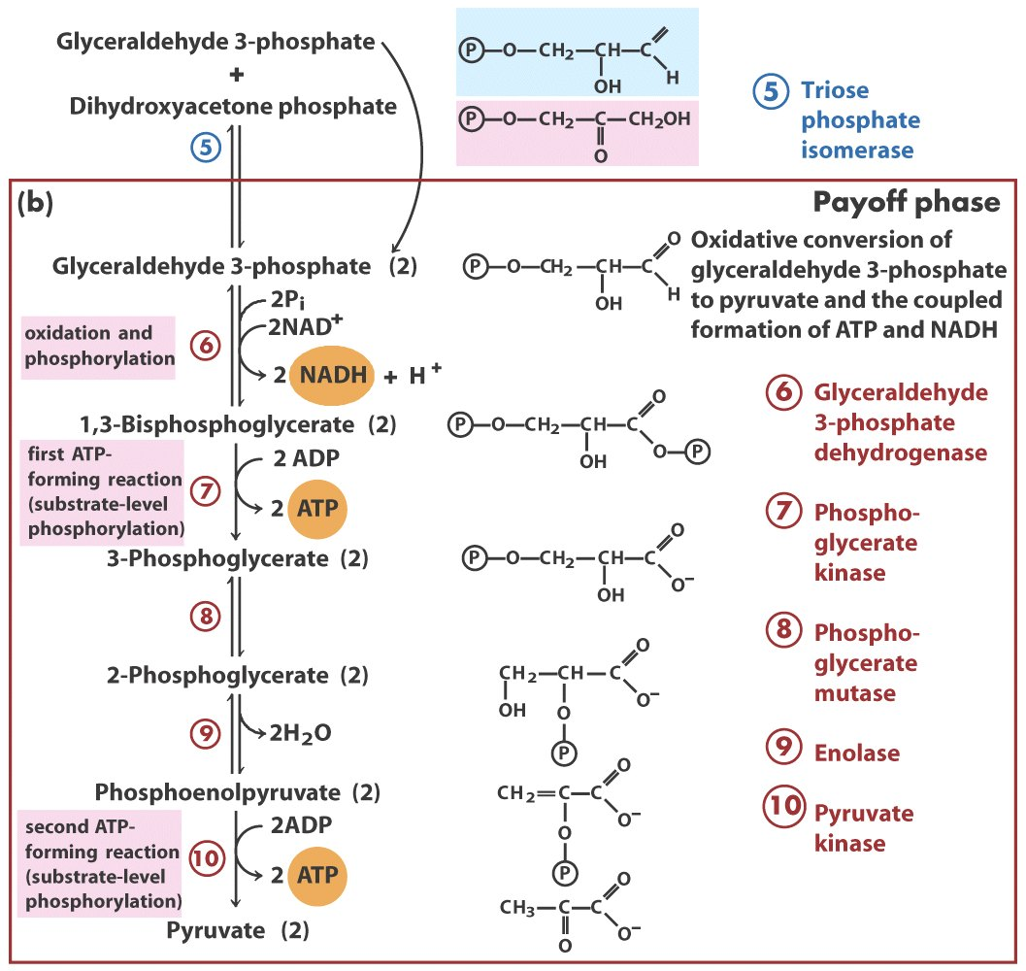
Payoff phase
O
⊗As
arsenate
⊗F⁻

Slide 17
Regulation of rate of reactions
allosteric
hormonal
gene exp.
A
A
A
Hormone 1-activates Enz
B
B
B
[Enz]
C
C
C
Enz
Enz
Enz
D
D
D
Enz
[Enz]
E
E
E
Hormone 2-inactivates Enz

Slide 18
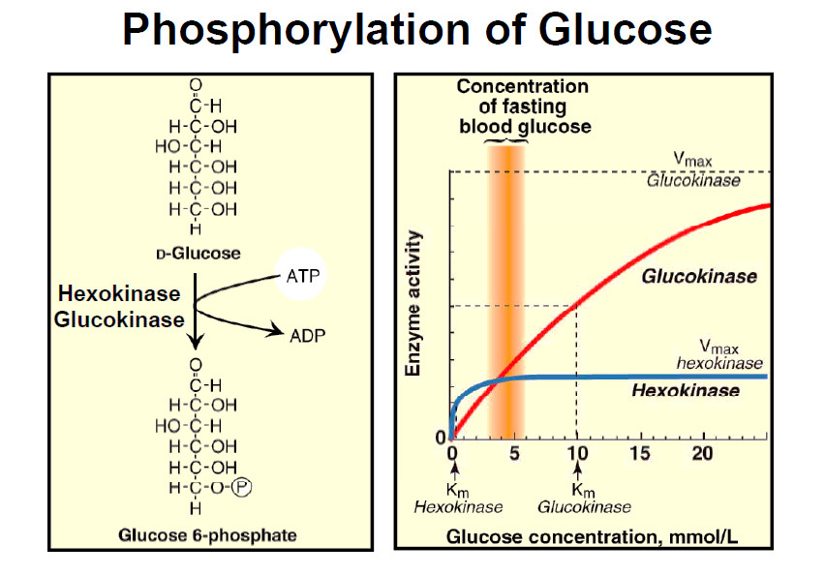
Reaction 1: Phosphorylation of glucose-
HK mediated
Mg²⁺
Hexokinase (HK)
Glucose + ATP
G-6-phosphate + ADP
HK has µM affinity to glucose (saturated under physiological levels)
Expressed in many tissues/ primary enzyme of glycolysis
Negatively regulated by glucose-6-phosphate accumulation

Slide 19
Reaction 1: Phosphorylation of glucose-
GK mediated
Mg²⁺
Glucokinase (GK)
Glucose + ATP
G-6-phosphate + ADP
GK has low mM affinity
Insensitive to glucose-6-phosphate
Expressed in glucose sensing cells
Q-What are examples of glucose sensing cells?

Slide 20
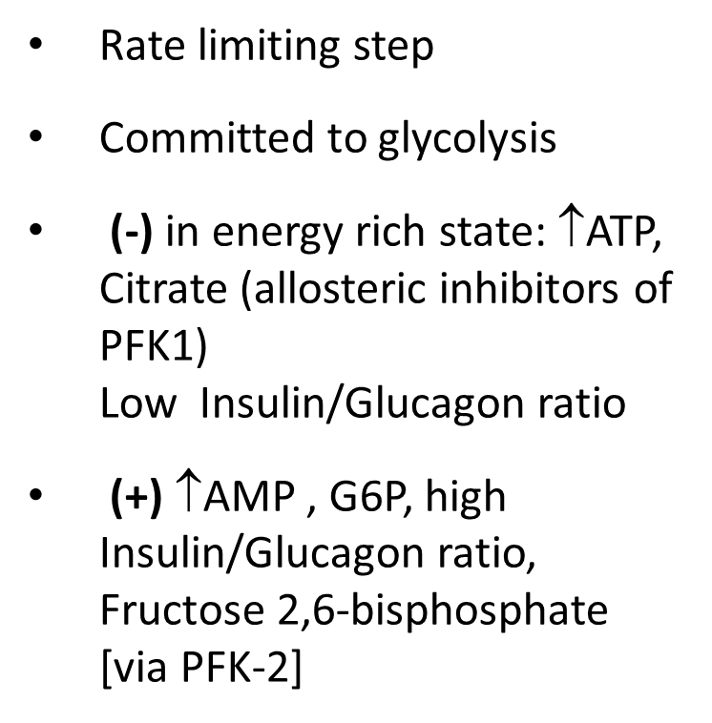
Reaction 3: Phosphofructokinase 1(PFK-1)
Fructose-6-phosphate
ATP
ATP, citrate
PFK-1
AMP
ADP
Fructose 2,6-bisphosphate
Fructose 1,6-bisphosphate

Slide 21
Reaction 10: Pyruvate kinase
Glucagon
Glucagon receptor
Adenylyl
cyclase
ATP
cAMP + PPi
Phosphoenol pyruvate
Active protein kinase A
fructose -1,6 bisphosphate
ATP
ADP
ADP
Pyruvate kinase (inactive)
Pyruvate kinase (Active)
ATP
ATP
P
Pyruvate

Slide 22
Fates of pyruvate
LDH
pyruvate
lactate
PC
PDH
oxaloactetate
pyruvate
Acetyl CoA
Citrate
Pyruvate has 3 fates
The preference of pathway depends on
Type of cell/expression of enzymes
Energy state of cell
Oxygen availability
Oxaloacetate
Isocitrate

Slide 23
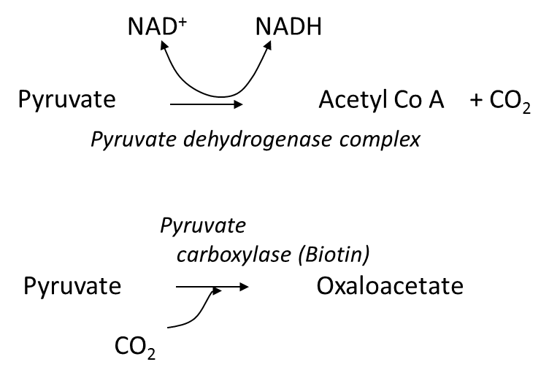
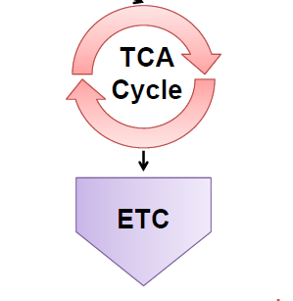
Aerobic glycolysis
pyruvate
↓
acetyl CoA
↓
TCA intermediate

Slide 24
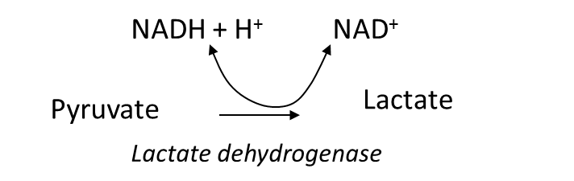
Anaerobic glycolysis
NAD⁺ regeneration required to continue glycolysis-essential in red blood cells
Converted to glucose via Cori cycle

Slide 25
Cori cycle
Glucose
Glucose
Glucose
pyruvate
( consumes ATP)
Gluconeogenesis
ATP
Glycolysis
Lactate
Lactate
Lactate
Liver
RBCs , muscles, brain
Other related cycle- Glucose-Alanine cycle

Slide 26
Synthesis of 2,3 –BPG in red cells
1,3-bisphosphoglycerate
bisphosphoglycerate mutase
ADP
2,3-bisphosphoglycerate
ATP
2,3-bisphosphoglycerate phosphatase
3-phosphoglycerate
2,3-BPG binds to deoxy-hemoglobin and ↓ the O₂ affinity of Hb
One step of ATP synthesis is bypassed (reaction 7)
Find out the role of 2,3-BPG in,
- regulating oxygen delivery to the tissues
- adaptation to high altitudes
- fetal hemoglobin
Notes:
26

Slide 27
Clinical applications of glycolysis- I
Genetic deficiencies
Most common is deficiency of pyruvate kinase in RBC (autosomal recessive)
Insufficient ATP production leads to haemolysis (Anaemia, Jaundice)
Other (rare) deficiencies
PFK-1 deficiency in muscles (exercise intolerance)
Blood sample collection for glucose measurements
Glycolysis inhibited by lowering temp and adding fluoride ions

Slide 28
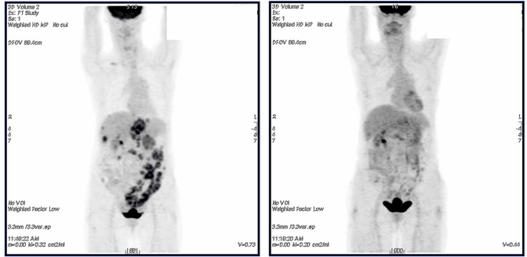
Clinical applications of glycolysis- II
Most cancer cells have high rate of glycolysis – rapid glucose uptake
A radiolabelled sugar analogue (FDG) can be used to monitor cancers using PET scanning method
Before treatment
After treatment

Slide 29
Summary
Glycolysis is the first step of glucose (and other monosachcharide) metabolism
Can take place under both aerobic and anaerobic conditions and produce 2 ATP and 2 NADH
Total of 10 reaction steps, 3 of them are regulatory steps.
PFK-1 mediated conversion of fructose-6-phosphate to fructose 1,6-bisphosphate is the main regulatory point.
Pathway is regulated by both allosteric and covalent modulation
Under anaerobic conditions, conversion of pyruvate to lactate is essential for continuation of glycolysis (e,g. red blood cells)
Inherited defects of glycolytic enzymes can cause haemolytic anaemia and muscle fatigue

Slide 30
Thank you!! Questions?

